Slide 1
Database systems I
Lecture FOUR

Slide 2
Database indexing
Data is stored in the form of records. Every record has a key field, which helps to recognize it uniquely.
Indexing is a data structure technique to efficiently retrieve records from the database files based on some attributes on which the indexing has been done.
Indexing in database systems is similar to what we see in books

Slide 3
Database indexing types
Indexing is defined based on its indexing attributes. It can be of the following types
Primary Index
Primary index is defined on an ordered data file. The data file is ordered on the primary key field.
In the primary index there is a one-to-one relationship between the entries in the index table and records in the main table.
Primary index is used on a primary key.
There are two types of primary index: dense and sparse indexes

Slide 4
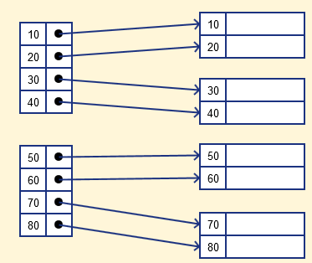
Primary index
a. Dense Index
In a dense index, a record is created for every search key valued in the database.
This helps you to search faster but needs more space to store index records.
In this Indexing, method records contain search key value and points to the real record on the disk.

Slide 5
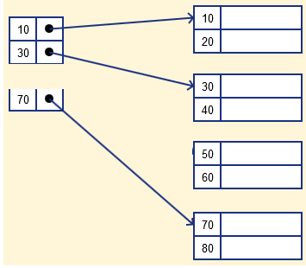
Primary index
b. Sparse Index
It is an index record that appears for only some of the values in the file.
Sparse Index helps you to resolve the issues of dense Indexing in DBMS.
In this method of indexing technique, a range of index columns stores the same data block address.
To search a record, we first proceed by index record and reach at the actual location of the data. If the data we are looking for is not where we directly reach by following the index, then the system starts sequential search until the desired data is found.

Slide 6
2. Secondary index
In secondary indexing, to reduce the size of mapping, another level of indexing is introduced.
In this method, the huge range for the columns is selected initially so that the mapping size of the first level becomes small.
Then each range is further divided into smaller ranges.
The mapping of the first level is stored in the primary memory, so that address fetch is faster.
The mapping of the second level and actual data are stored in the secondary memory (hard disk).

Slide 7
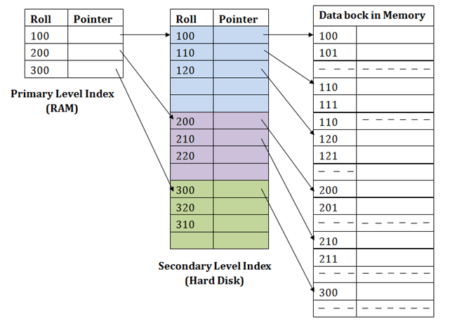
2. Secondary index

Slide 8
3. Clustered Index
A clustered index can be defined on an ordered data file. Sometimes the index is created on non-primary key columns which may not be unique for each record.
In this case, to identify the record faster, we will group two or more columns to get the unique value and create index out of them. This method is called a clustering index.
The records which have similar characteristics are grouped, and indexes are created for these group

Slide 9
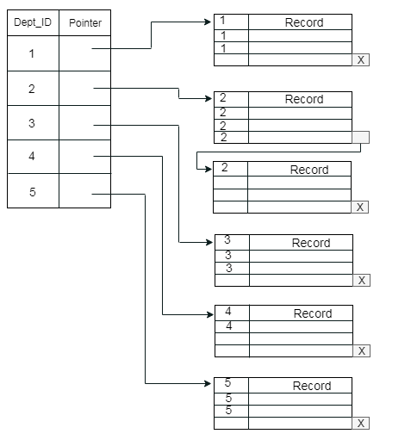
3. Clustered Index

Slide 10
Advantages of using indexes in SQL language
Their use in queries usually results in much better performance.
They make it possible to quickly retrieve (fetch) data.
They can be used for sorting. A post-fetch-sort operation can be eliminated.
Unique indexes guarantee uniquely identifiable records in the database

Slide 11
Transactions
The concept of a transaction has become central to many database applications.
A transaction is an executing program or process that includes one or more database accesses, such as reading or updating of database records. Each transaction is supposed to execute a logically correct database access if executed in its entirety without interference from other transactions.
The DBMS must enforce several transaction properties.

Slide 12
Transactions
A simple example of a transaction will be dealing with the bank accounts of two users, let say Karlos and Ray.
A simple transaction of moving an amount of 5000 from Karlos to Ray engages many low-level jobs.
As the amount of Ksh. 5000 gets transferred from the Karlos's account to Ray's account, a series of tasks gets performed in the background of the screen.

Slide 13
ACID properties of a transaction
A transaction in a database system must maintain Atomicity, Consistency, Isolation, and Durability − commonly known as ACID properties − in order to ensure accuracy, completeness, and data integrity.
Atomicity − This property states that a transaction must be treated as an atomic unit, that is, either all of its operations are executed or none. There must be no state in a database where a transaction is left partially completed. States should be defined either before the execution of the transaction or after the execution/abortion/failure of the transaction.

Slide 14
ACID properties
Consistency − The database must remain in a consistent state after any transaction. No transaction should have any adverse effect on the data residing in the database. If the database was in a consistent state before the execution of a transaction, it must remain consistent after the execution of the transaction as well.
Durability − The database should be durable enough to hold all its latest updates even if the system fails or restarts. If a transaction updates a chunk of data in a database and commits, then the database will hold the modified data. If a transaction commits but the system fails before the data could be written on to the disk, then that data will be updated once the system springs back into action.

Slide 15
ACID properties
Isolation − In a database system where more than one transaction are being executed simultaneously and in parallel, the property of isolation states that all the transactions will be carried out and executed as if it is the only transaction in the system. No transaction will affect the existence of any other transaction.

Slide 16
Application of Databases
Banking: For customer information, accounts, loans, and banking transactions.
Credit card transactions: For purchases on credit cards and generation of monthly statements.
Finance: For storing information about holdings, sales, and purchases of financial instruments such as stocks and bonds; also for storing real-time market data to enable online trading by customers and automated trading by the firm.
Universities: For student information, course registrations, and grades (in addition to standard enterprise information such as human resources and accounting).
Airlines: For reservations and schedule information. Airlines were among the first to use databases in a geographically distributed manner

Slide 17
Application of Databases
Telecommunication: For keeping records of calls made, generating monthly bills, maintaining balances on prepaid calling cards, and storing information about the communication networks.
Sales: For customer, product, and purchase information.
Accounting: For payments, receipts, account balances, assets and other accounting information.
Human resources: For information about employees, salaries, payroll taxes, and benefits, and for generation of paychecks.
Manufacturing: For management of the supply chain and for tracking production of items in factories, inventories of items in warehouses and stores, and orders for items.

